Slide 1
Displaying sensor values while a robot is running

Slide 2
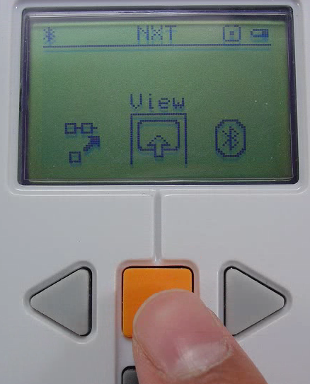
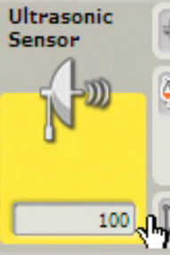
To view sensor data from a robot you can use the View Mode on the NXT or plug the robot in and use the programming software tools.

Slide 3
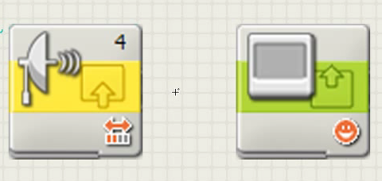
Steps to Monitoring Sensor Values as the Robot is Running.
First you need a Senor Block that will read the sensor value.
Followed by a Display Block that will show the value from the senor on the screen of the NXT

Slide 4
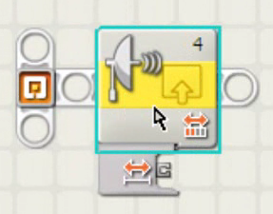
Begin with an Ultrasonic Senor Block.
Place the yellow Ultrasonic Senor Block on the beam.
The plug needed is already showing.

Slide 5
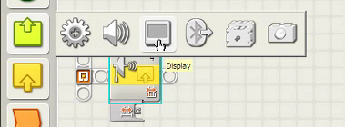
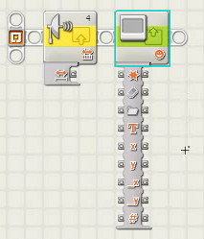
Place a Display Block after the Ultrasonic Block.
Click on the lower left corner to open the Data Hub.

Slide 6
Change the Display setting from Image to Text.
The text will be over written with the sensor value. For now type the word sensor value in the text box.

Slide 7
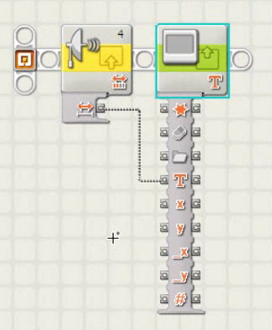
Wire the Distance plug on the Ultrasonic Sensor to the Text plug on the Display Block
Note the black and white wire.
Download the program to the NXT.

Slide 8
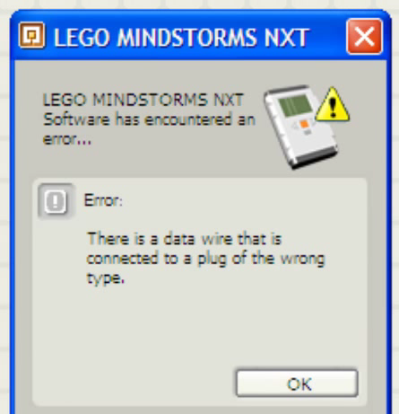
The NXT recognizes three different kinds of values:
Numbers
Whole numbers positive or negative (Integers)
Text
A collection of letters strung together to make words or sentences
Logic Values
True or False

Slide 9
The error occurs because the Display Block is set to display text.
The Ultrasonic Sensor is sending out a Number Value to the Display Block.
Numbers and Text are two different types of values to the NXT.
Display Blocks do not have the number Display option so a number must be converted to text.

Slide 10
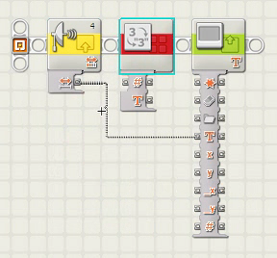
Use the Red Advanced Palette and select the Number to Text Block.
Place it between the Ultrasonic Sensor and the Display Block.

Slide 11
Number to Text Block Details
This block converts a number to a series of characters recognized by the NXT as Text.
This conversion allows you to display a Number as Text however, the NXT no longer understands it as a number so trying to do any type of mathematical functions like adding or subtracting will not work.

Slide 12
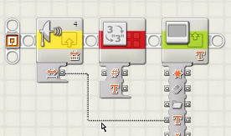
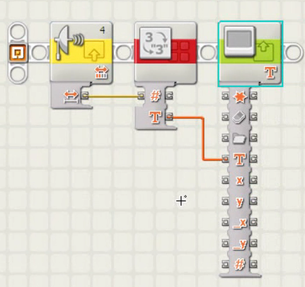
Delete the bad wire between the Distance Plug and the Display Plug by clicking on it and pressing delete.
Wire the Ultrasonic Distance Output Plug to the Number Input Plug on the Conversion Block. The Text Output Plug on the Conversion Block goes to the Text Input Plug on the Display Block.

Slide 13
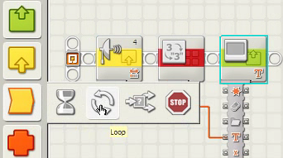
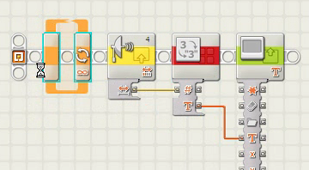
To update continuously in real time a loop is required.
Be careful not to break any wires when selecting and dragging the program inside the loop.

Slide 14
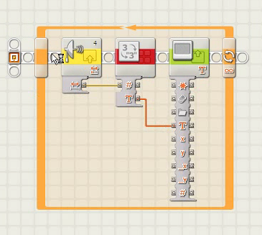
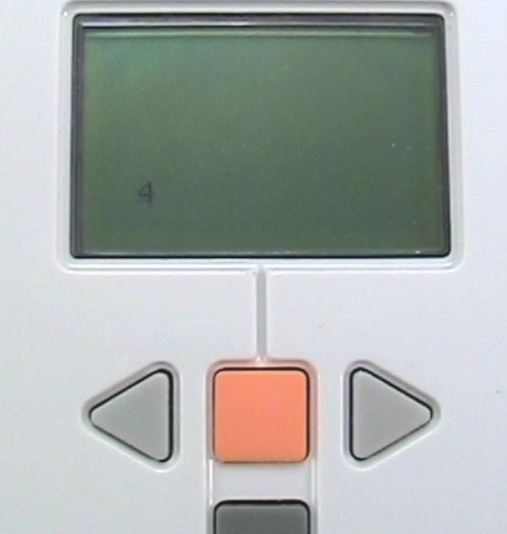
The Ultrasonic sensor values should be displayed on the NXT screen.
Download and run the program.

