Slide 1
Sensors and Logic Switches
Creating a robot that sees a range of shades of colors

Slide 2
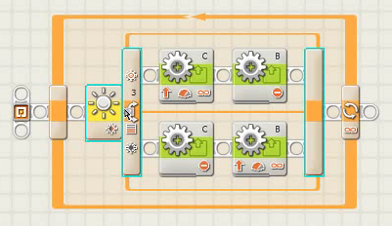
The Line Following program checks to see if the light sensor value is above or below the threshold value.
It does not check for values that fall between two numbers that can be required when different color shades in the “gray” range need to be detected.

Slide 3
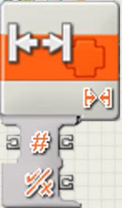
The Range Block uses a data hub to accept a value from one block checks to see if it’s in a defined range, and then sends out a true false logic value depending on whether the number was in the range - true if it was false if it wasn’t.

Slide 4
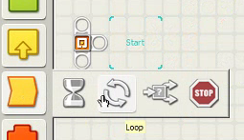
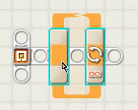
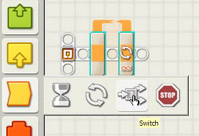
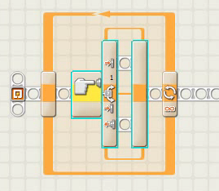
Start with a switch loop combo.

Slide 5
Configuring the switch loop combo.
Leave the loop running forever so it continuously checks.
Set the switch control to Value and Type to Logic. Logic value allows any combination of reading and checking as long as the result is a true or false. (a yes, runs the top path or a no runs the bottom path)

Slide 6
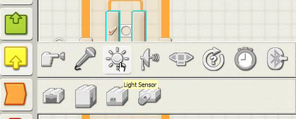
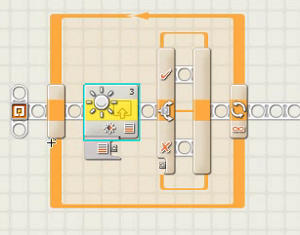
Setting a Light Sensor for an acceptable range.
Open the Sensor Palette and select the Light Sensor Block.

Slide 7
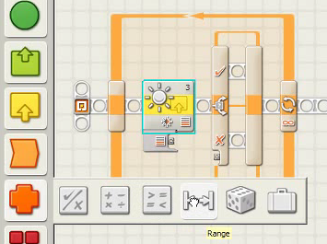
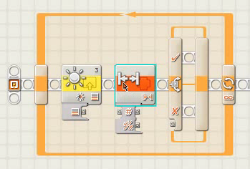
Setting a Light Sensor for an acceptable range.
Open the Data Palette and select the Range Block.

Slide 8
Configuring the Range Block
The Range Block should be configured to show an inside range between 32 and 47.
The Range Block will test the wired in value and return a True or False on whether the tested number is between 32 and 47: True for Yes and False for No.

Slide 9
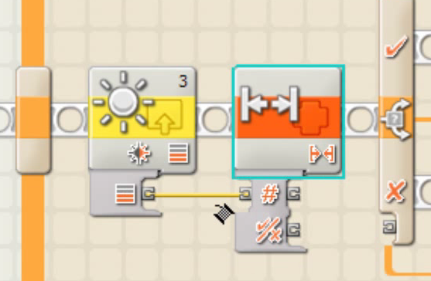
Wiring the Blocks
Wire the Light Intensity output plug on the Light Sensor Block to the Test Value input plug on the Range Block.
The Range Block will test the light intensity from the Light Sensor Block to see if it is in the range from 32 to 47.

Slide 10
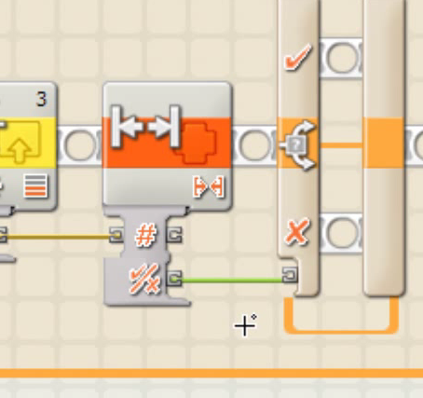
Configuring the Range Block
Wire the Yes/No output plug on the Range Block to the unmarked logic plug on the Switch Block. The range check will determine if the Switch Block follows the top half or bottom half.
A number in the range returns a True comparison, the true top blocks runs. A number outside the range returns a False comparison, the False bottom blocks runs.

Slide 11
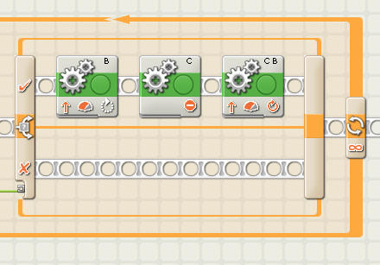
Configuring the True, Top Run Blocks
The sensor detected a value within the range. Meaning the color changed and a turn is required. The robot should make a 90 degree point turn and go forward for 2 rotations.

Slide 12
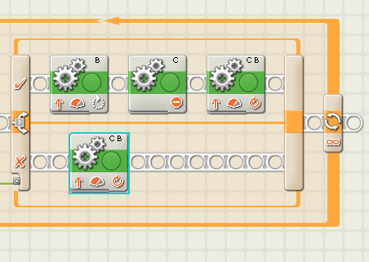
Configuring the False, Bottom Run Blocks
The sensor detected a value outside the range. Meaning the color remained the same. The robot should continue on it’s straight course going forward for 1 rotation before checking again.

