Slide 1
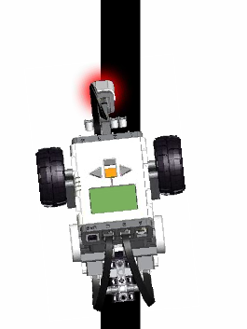
Line Following Behavior

Slide 2
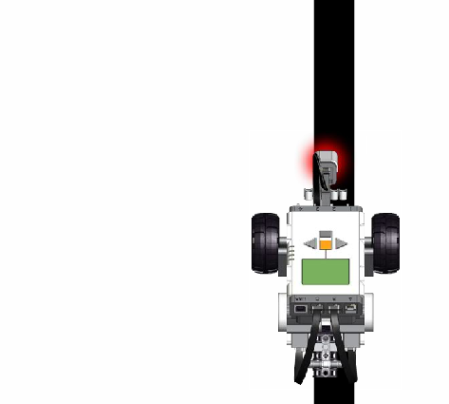
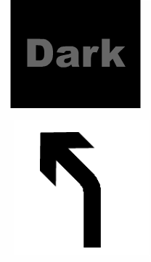
The robot moves forward always following the left edge of the line.
The robot is on top of the line, the Light sensor see’s Dark which directs it to go left (and forward).
If the robot continues this behavior it will drive off the line.

Slide 3
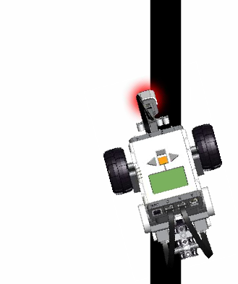
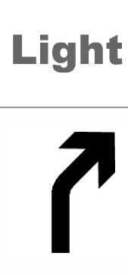
The robot continues to move forward following the left edge of the line.
The robot is on the light area next to the line, the Light sensor see’s Light which directs it to go right (and forward).

Slide 4
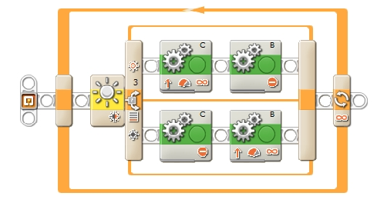
Line Following Program

Slide 5
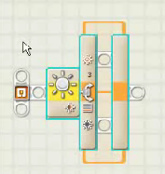
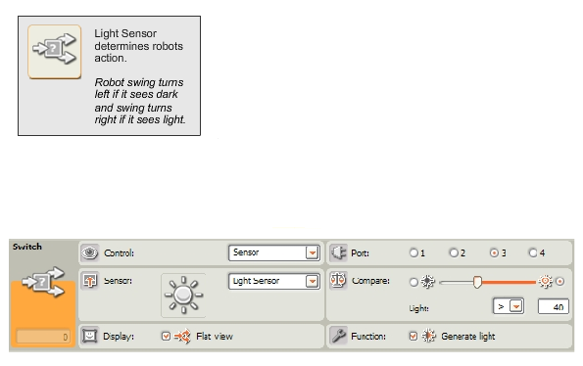
Switch Block Details

Slide 6
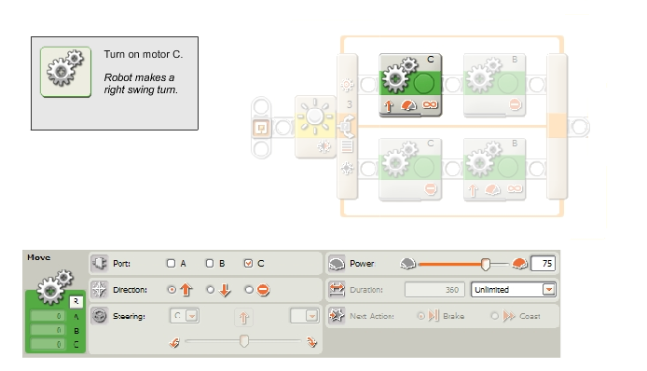
Light Surface Motor C Swing Turn Details

Slide 7
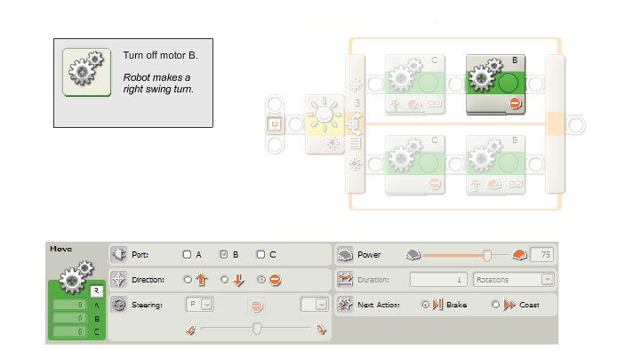
Light Surface Motor B Swing Turn Details

Slide 8
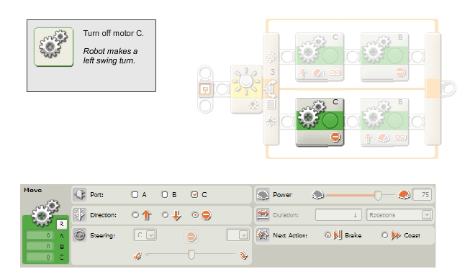
Dark Surface Motor C Swing Turn Details

Slide 9
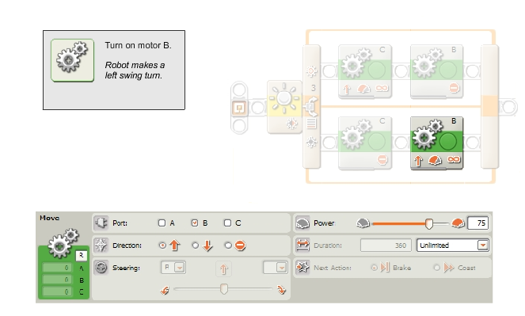
Dark Surface Motor B Swing Turn Details

Slide 10
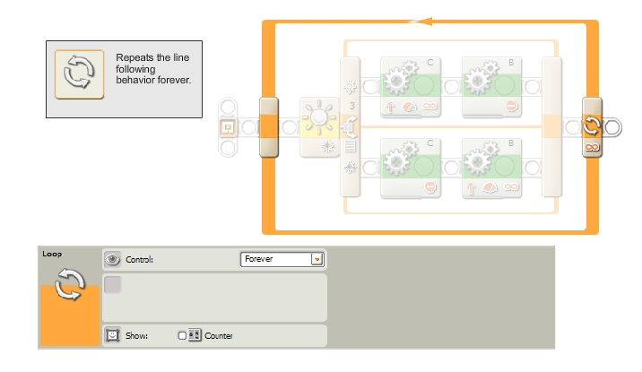
Loop Block Details Remember to drag the switch block inside the loop block

Slide 11
Test the Robots Line Following Behavior.

Slide 12
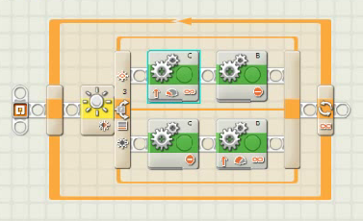
Optimizing the Line Following Behavior for a Curvy Line
Different combinations of power levels yield better performance on different types of curves.

Slide 13
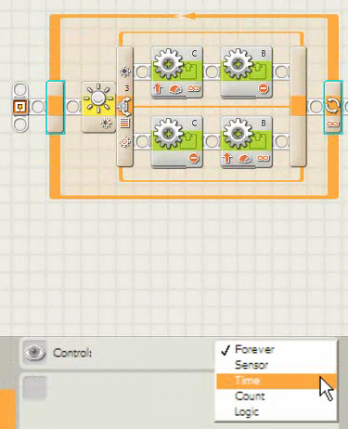
Change the Loop from a forever loop to a timed loop of 10 seconds. When 10 seconds are up the loop ends and so does the line tracking program.

Slide 14
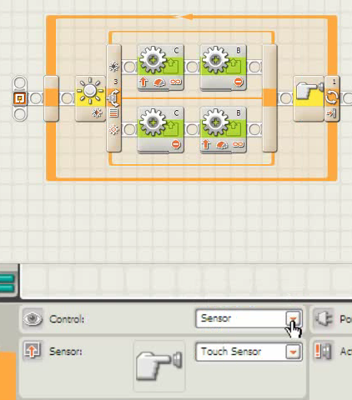
Change the Loop from a timed loop to a touch sensor loop. The loop ends when the touch sensor is pressed and so does the line tracking program. Loops can be used to run behaviors until something tells them to stop.

Slide 15
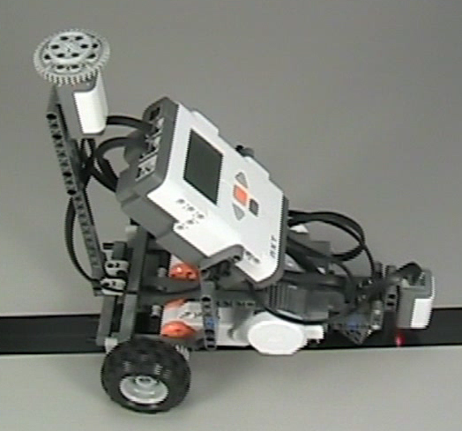
The Looped behaviors
The loop block repeat-until behavior is still the simplest way to control when the behavior stops.
The loop will repeat the behavior inside it until the stopping condition is reached and then continue on with the program.

Slide 16
Limits to looped behaviors
In order for a loop-until control method to work, you can’t use any behavior inside the loop that force the program to wait or other wise prevent it from reaching the end of the loop.
The reason for this is the loop has to reach its end block to check whether it should stop or not. If it can’t check the endblock regularly, it may miss the signal to end.
This includes putting loops inside each other, because the inner loop prevents the program from reaching the outer loop to check.

